Slide 1
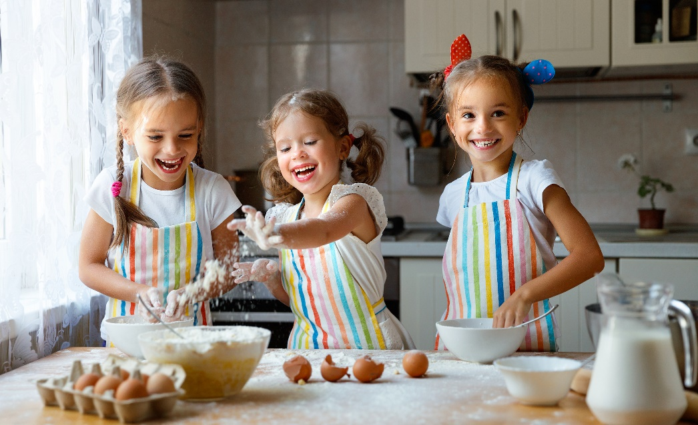
Cookies and Sessions
How cookies work
Attributes of a cookie
Sessions

Slide 2
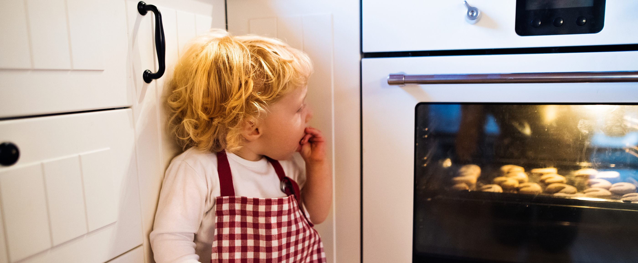
See Also
https://en.wikipedia.org/wiki/HTTP_cookie
https://technobeans.com/2012/08/07/tornado-cookies/
Notes:
Some additional information on concurrency

Slide 3

Cookies
HTTP requests are isolated.
The server needs a way to track state between requests (like for authentication).
The server asks the client to store cookies.
The browser then sends the cookies with every request.
Cookies have a “maximum age”.
Session cookies have a max age of -1, and they live until the browser is shut down.
Streams of bytes … two ways (into your program and out of your program)
Disks, consoles, sockets, keyboards, printers
Know how to talk streams and you can talk to anything
Initialization (constructor) is different. Use is the same.

Slide 4
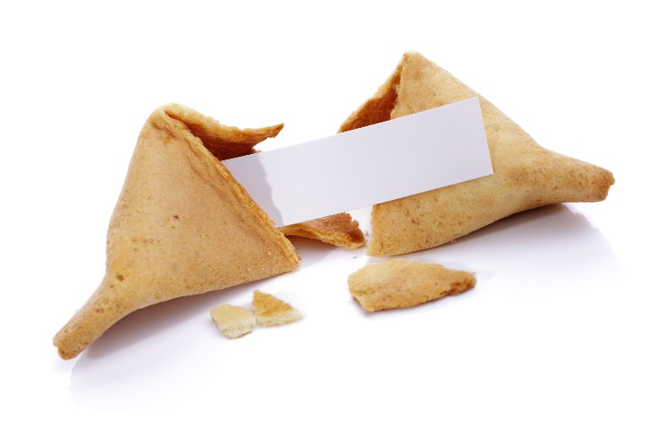
Server Sends “Set-Cookie”
GET /index.html HTTP1.0
User-Agent: Mozilla/4.0
Accept-Language: en-us
HTTP/1.1 200 OK
Content-Type: text/html
Set-Cookie: flavor=chocolate
<html><body>Hello</body></html>
GET /other.html HTTP1.0
User-Agent: Mozilla/4.0
Cookie: flavor=chocolate
flavor=chocolate
GET /hello HTTP1.0
User-Agent: Mozilla/4.0
Cookie: flavor=chocolate
Streams of bytes … two ways (into your program and out of your program)
Disks, consoles, sockets, keyboards, printers
Know how to talk streams and you can talk to anything
Initialization (constructor) is different. Use is the same.

Slide 5
Parts of a Cookie
Set-Cookie:
flavor=chocolate;
Path=/code/sub;
Domain=my.com;
Expires=Sat, 04-Jun-2016 18:57:28 GMT;
Max-Age=360;
Comment=testing;
HttpOnly;
Secure
Name and Value
What URLs get the cookie (within the domain)
What domains get the cookie (like books.my.com and pets.my.com)
When the browser should delete
The new (best) way, but <IE9 does not support it
Miscellaneous info about the cookie
Cannot be accessed by javascript
Only sent to “https” (secure) URLs
Streams of bytes … two ways (into your program and out of your program)
Disks, consoles, sockets, keyboards, printers
Know how to talk streams and you can talk to anything
Initialization (constructor) is different. Use is the same.

Slide 6
Cookies in Tornado
self.set_cookie("cookieName", "value", expires=exactTime)
self.set_cookie("cookieName", "value", expires_days=30)
self.clear_cookie("cookieName")
c = self.cookies()
self.get_cookie("name", None)
self.set_secure_cookie( ... )
Does the math for you
What to return if cookie is not found

Slide 7
Cookie Playground
class MyHandler(tornado.web.RequestHandler):
def get(self):
self.write("Cookies sent by browser:"+str(self.cookies)+"<br>")
cookieName = self.get_argument("name",None)
cookieValue = self.get_argument("value","1234")
cookieClear = self.get_argument("clear",None)
cookieDays = self.get_argument("days",None)
if cookieDays:
cookieDays = float(cookieDays)
if cookieClear:
self.clear_cookie(cookieClear)
self.write("Clearing cookie "+cookieClear+"<br>")
if cookieName:
self.write("Setting cookie "+cookieName+"="+cookieValue+" days="+str(cookieDays))
self.set_cookie(cookieName,cookieValue,expires_days=cookieDays)
handlers = [("/cook", MyHandler)]
Streams of bytes … two ways (into your program and out of your program)
Disks, consoles, sockets, keyboards, printers
Know how to talk streams and you can talk to anything
Initialization (constructor) is different. Use is the same.

Slide 8
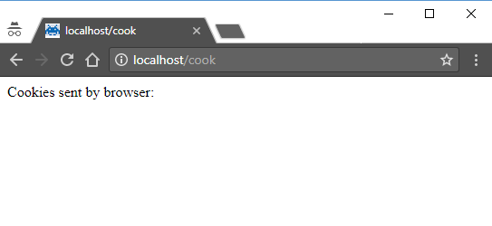
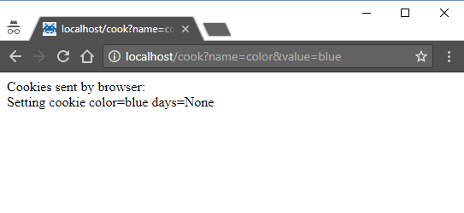
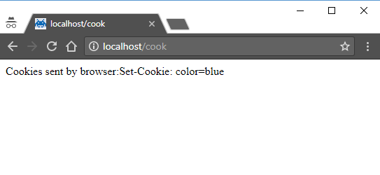
Cookie Playground

Slide 9
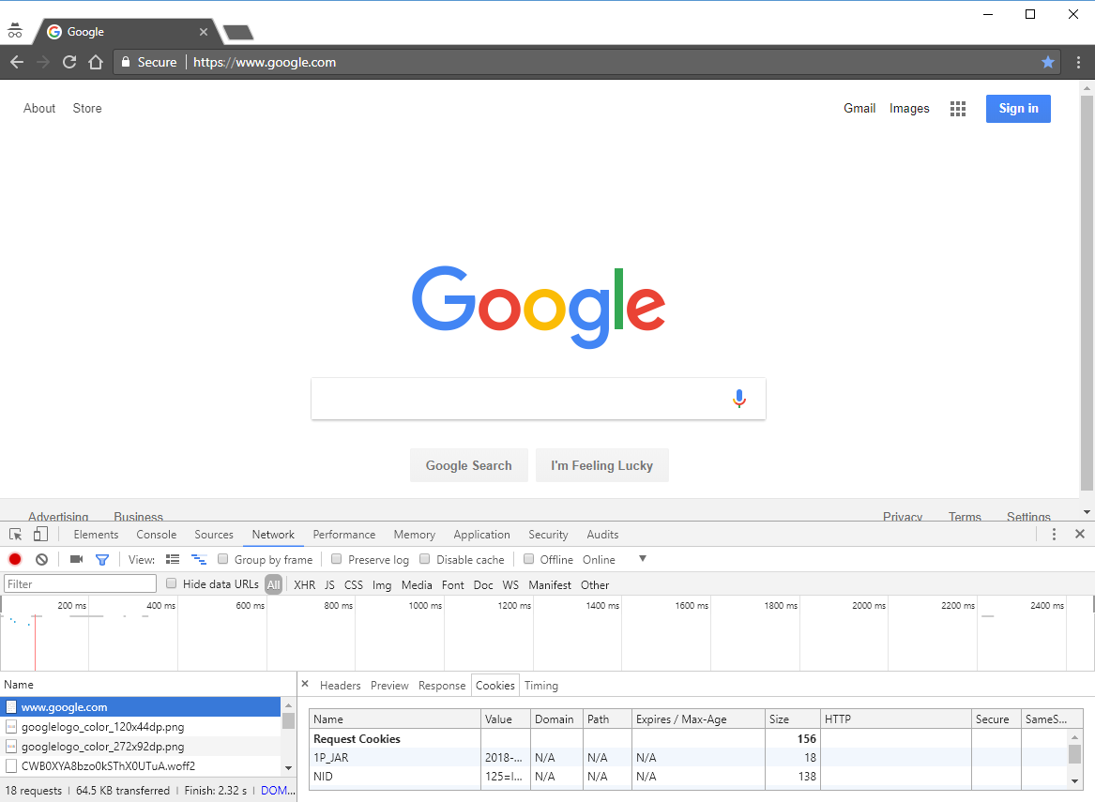
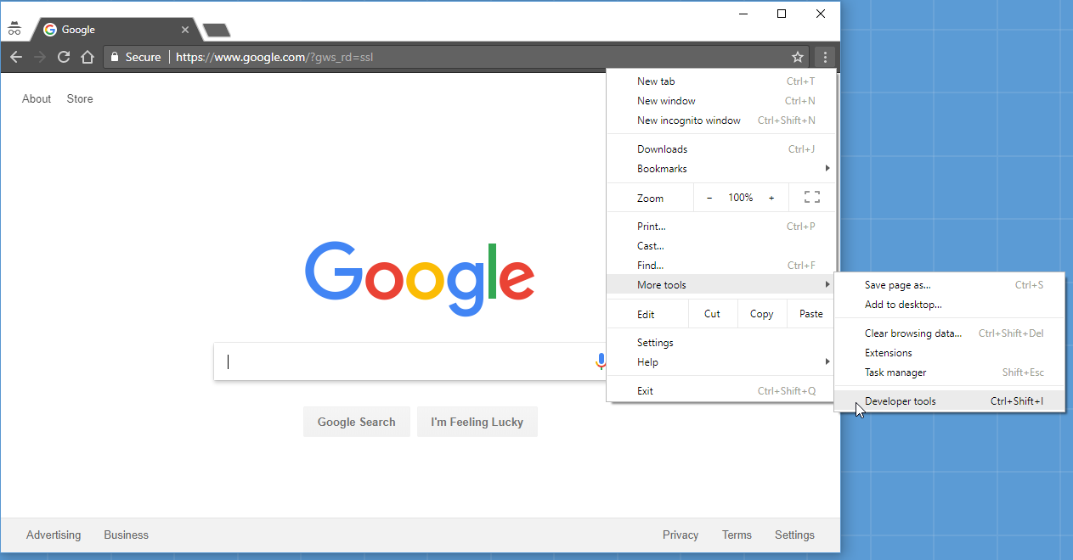
Developer Tools

Slide 10
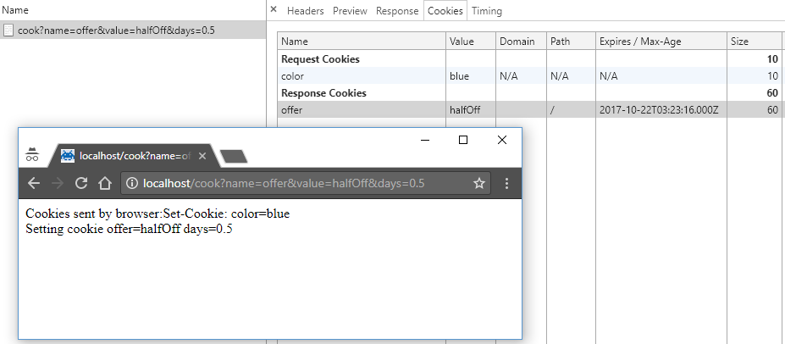
Cookie Playground

Slide 11
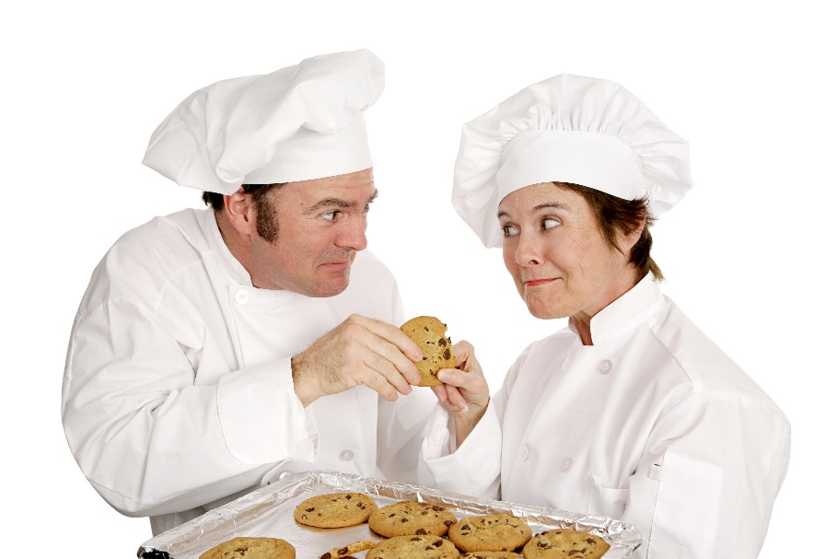
Sessions
Not built in to Tornado (other frameworks have it)
https://github.com/PlaidCloud/dustdevil
See how it works with our simple code
The session object lives in the Python VM on the server. Only the session id is passed around in the cookie.
Streams of bytes … two ways (into your program and out of your program)
Disks, consoles, sockets, keyboards, printers
Know how to talk streams and you can talk to anything
Initialization (constructor) is different. Use is the same.

Slide 12
Using Sessions
class SessionPlay(tornado.web.RequestHandler):
sessions = {}
next_id = 10000
def get(self):
logout = self.get_argument("logout",None)
user = self.get_argument("user",None)
password = self.get_argument("pass",None)
sid = self.get_cookie("sid",None)
if logout and sid:
self.clear_cookie("sid")
del SessionPlay.sessions[sid]
self.write("Logged out")
return
if user:
session = {"user":user, "password":password, "count":1}
sid = str(SessionPlay.next_id)
SessionPlay.next_id += 1
SessionPlay.sessions[sid] = session
self.set_cookie("sid",sid)
self.write("Logged in")
return
if not sid:
self.write("I don't know you (you have no cookie)")
return
if not sid in SessionPlay.sessions:
self.write("I don't know you (unknown sid)")
self.clear_cookie("sid")
return
session = SessionPlay.sessions[sid]
session["count"] += 1
self.write(str(session))
Streams of bytes … two ways (into your program and out of your program)
Disks, consoles, sockets, keyboards, printers
Know how to talk streams and you can talk to anything
Initialization (constructor) is different. Use is the same.

Slide 13
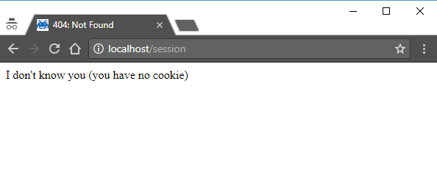
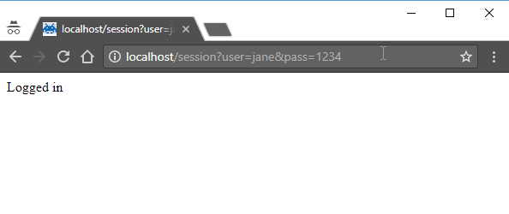
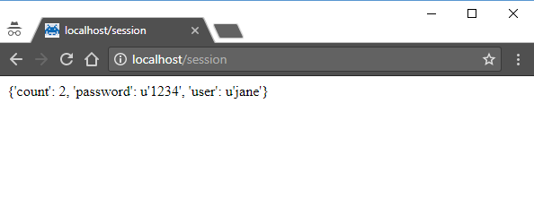

Sessions
Streams of bytes … two ways (into your program and out of your program)
Disks, consoles, sockets, keyboards, printers
Know how to talk streams and you can talk to anything
Initialization (constructor) is different. Use is the same.

Slide 14
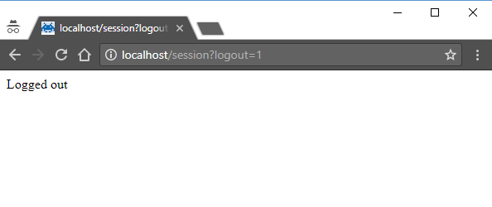

Sessions
Streams of bytes … two ways (into your program and out of your program)
Disks, consoles, sockets, keyboards, printers
Know how to talk streams and you can talk to anything
Initialization (constructor) is different. Use is the same.

Slide 15

Tinkering
Type in the CookiePlayground and the SessionPlayground. Make two handlers in the same server.
Use your browser to tinker with the playgrounds.
Use the browser dev tools to see the cookie exchanges.
Try using a session cookie in the HiLo code.

